Slide 1
Mobile Programming
Lecture 11

Slide 2
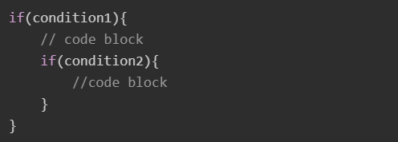
Nested if-else Statement
The nested if else statement is used for better decision-making when other conditions are to be checked when a given condition is true. In the nested if else statement, you can have an if-else statement block the another if (or, else) block.
Syntax
Below is the syntax of nested if else statement:

Slide 3
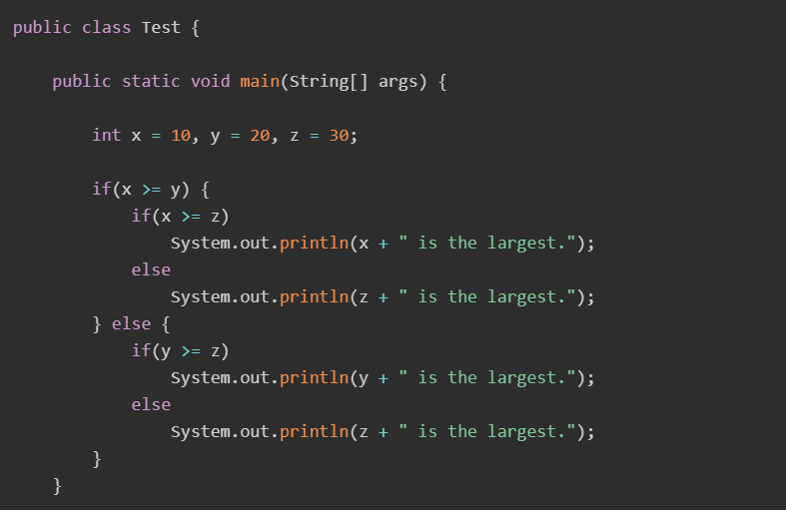
Example of Nested if else Statement
The following examples finds the largest number among three using nested if..else statement. The same problem we solved in our last class.

Slide 4
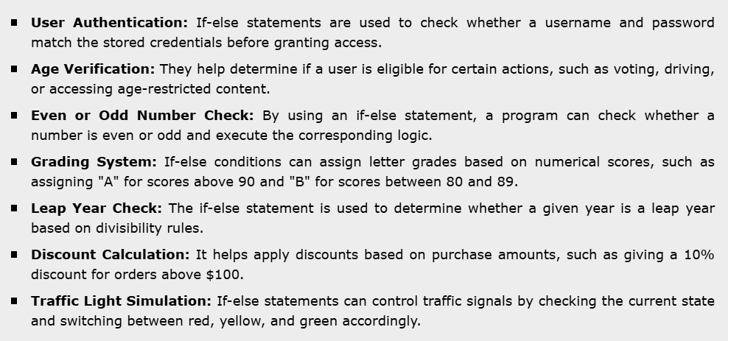
Use Cases of Java if-else Statement
The if-else statement in Java is useful for making decisions based on conditions. Below are some common use cases:

Slide 5
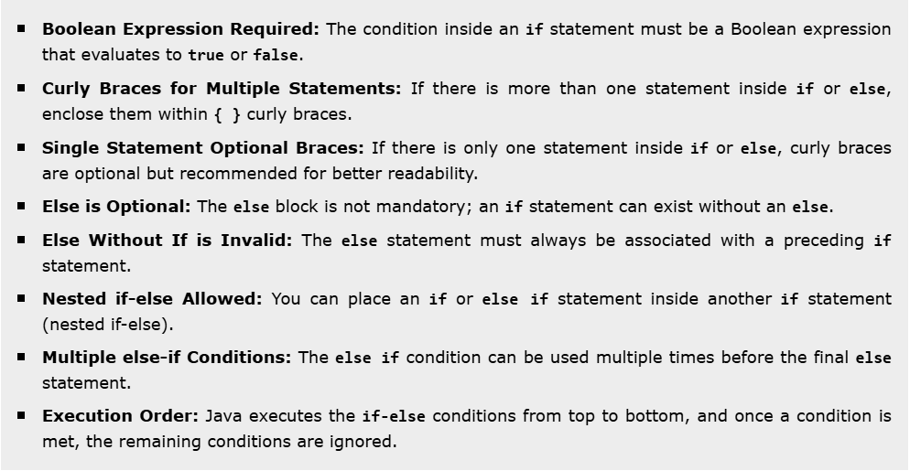
Rules for Using if-else Conditions
The if-else statement in Java follows specific rules to ensure proper execution. Below are the key rules:

Slide 6
Task 1:
Your task is to make code which checks your user input is it divisible to 7 and 5 or not. If it is, you have to print out the text “number is divisble to 7” if it is 5 your text has to look like “number is dividsible to 5”, If number is divisible to both numbers print “number is divisible to both numbers” otherwise “None divisible number”
Check for all conditions !

Slide 7
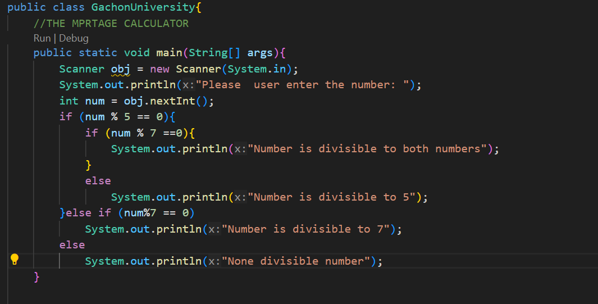
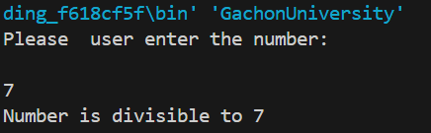
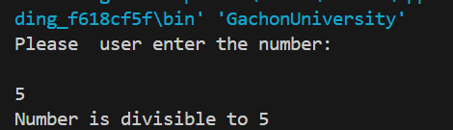
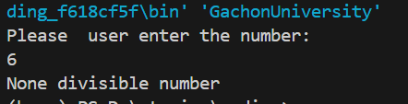
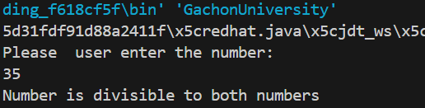

Slide 8
Task 2: You are given inputs ,they are the inputs for your calculator.
num1 = 10
num2 = 15
char operator = (+, -, *, /)
num1 and num2 are the numbers to operate on.
operator is the operation you want to perform (+, -, *, /). You have to check for all operators. As the default you have to give “Invalid operator”.
Your task is to make small calculator.
example:
if the char operator = ‘+’ , your answer 10+5=15

Slide 9
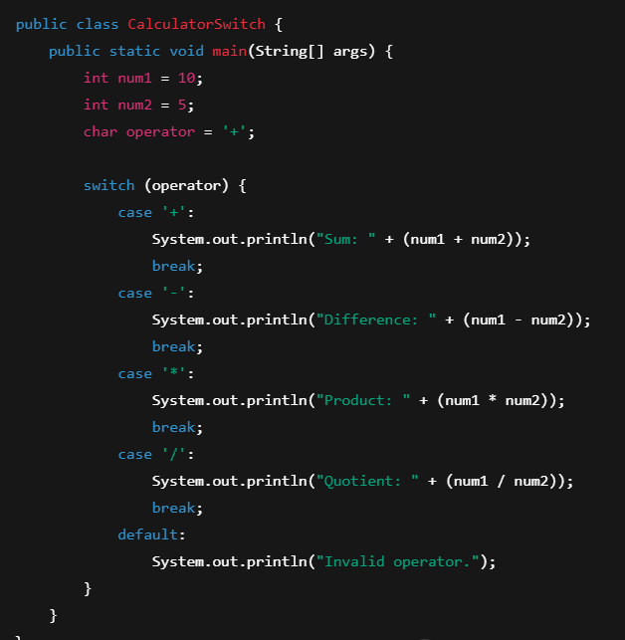
output:
15

Slide 10
Task 3
Your task is to check the user input nuber into is number divisible to 2 and 3. If number is divisible to 2 print “Fizz” if into 3 print “Buzz” if the number is divisble to both of the numbers print (“FizzBuzz”), itherwise print (“out of FizzBuzz”).

Slide 11
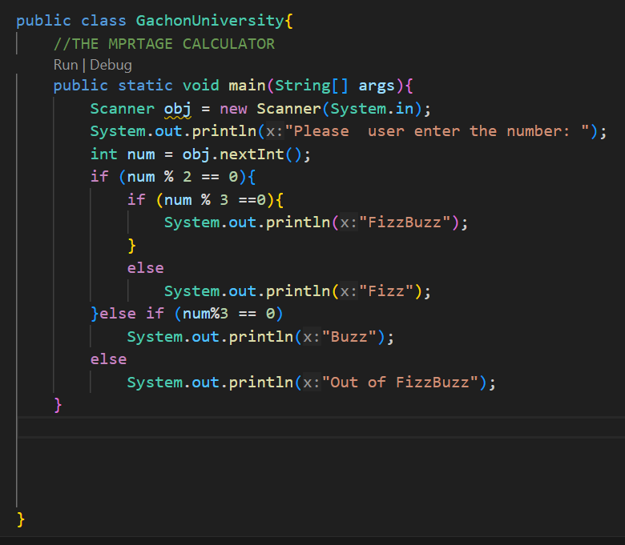
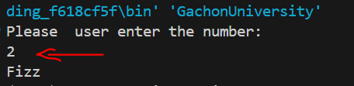
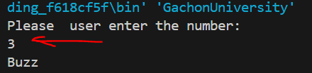
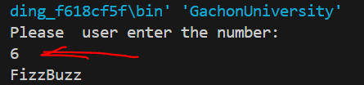


Slide 12
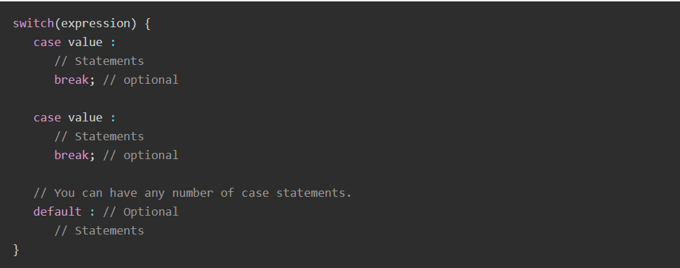
Java - switch statement
Java switch statement allows a variable to be tested for equality against a list of values. Each value is called a case, and the variable being switched on is checked for each case. The switch statement can be used when multiple if-else statements are required. It can have multiple code blocks along with the case values and execute one of many code blocks based on the matched case value.

Slide 13
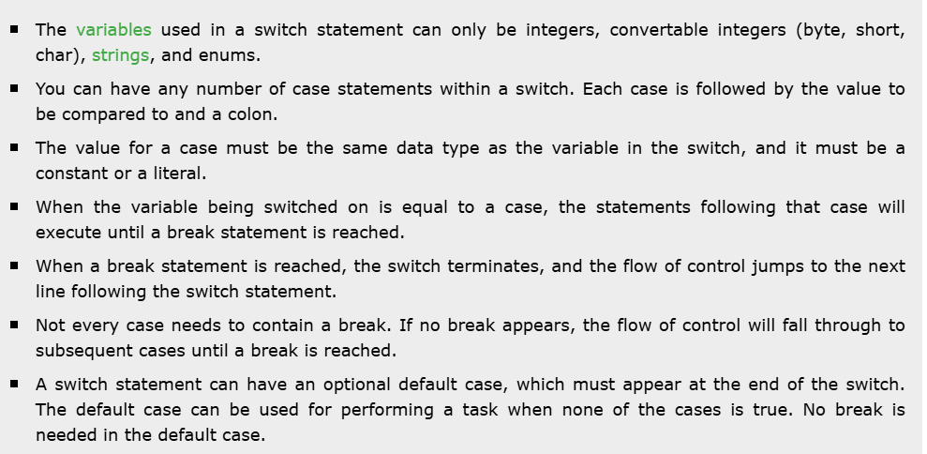
Rules for Using switch Statement
The following rules apply to a switch statement −

Slide 14
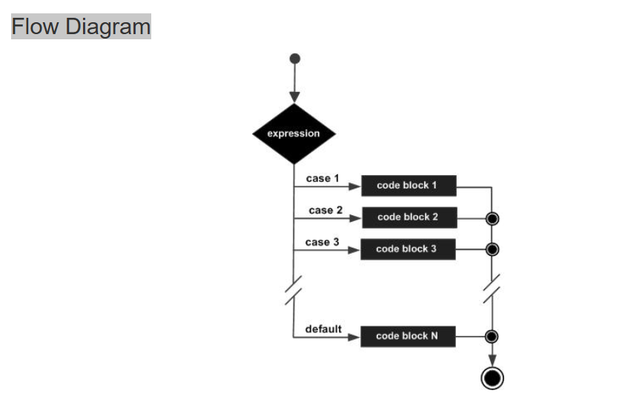

Slide 15
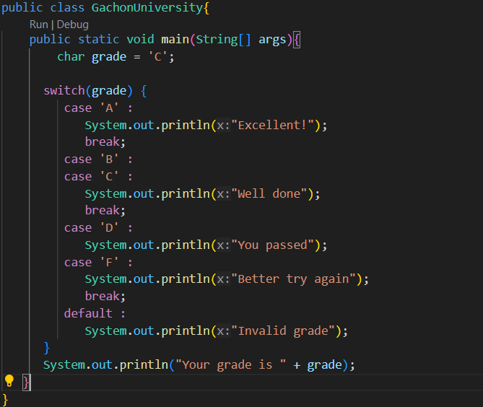

switch Statement Examples
Example 1
In this example, we're showing use of switch statement where cases are based on a char. We've created a variable grade. Based on value of grade, each case is checked. if a case is satisfied and break statement is present then following cases are not checked. this example for char
output

Slide 16
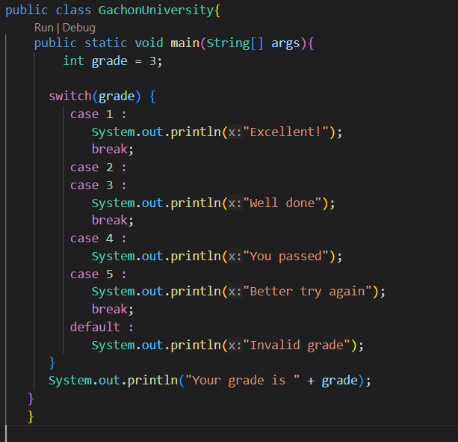

Example 2
In this example, we're showing use of switch statement where cases are based on a int. We've created a variable grade. Based on value of grade, each case is checked. if a case is satisfied and break statement is present then following cases are not checked. this example for int
output

Slide 17
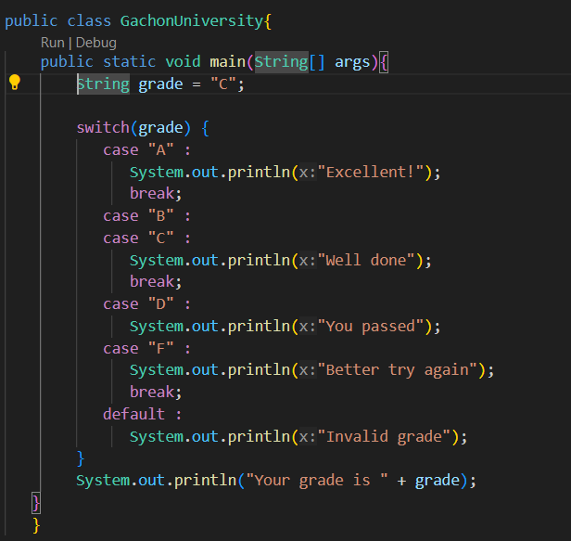
Example 3
In this example, we're showing use of switch statement where cases are based on a String. We've created a variable grade. Based on value of grade, each case is checked. if a case is satisfied and break statement is present then following cases are not checked. this example for string
output

Slide 18
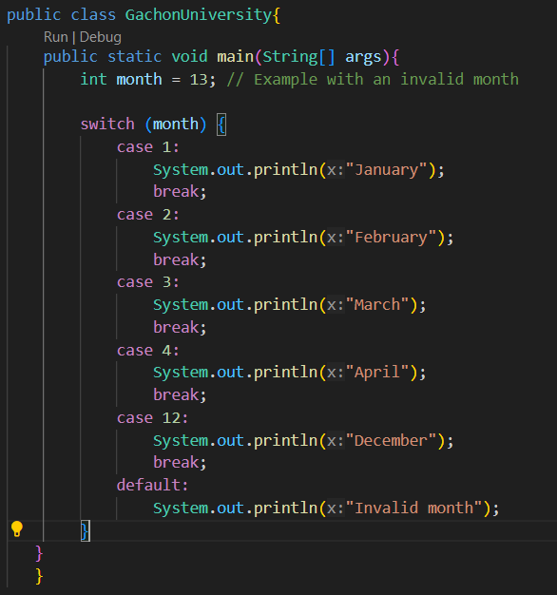

Using default Keyword With switch Statement
The default keyword is used to specify a code block when no case value is matched. The default keyword is optional, but it should be used in the switch case statement.
Example: With the default Keyword
The following example demonstrates the use of the default keyword with a switch statement:
Output

Slide 19
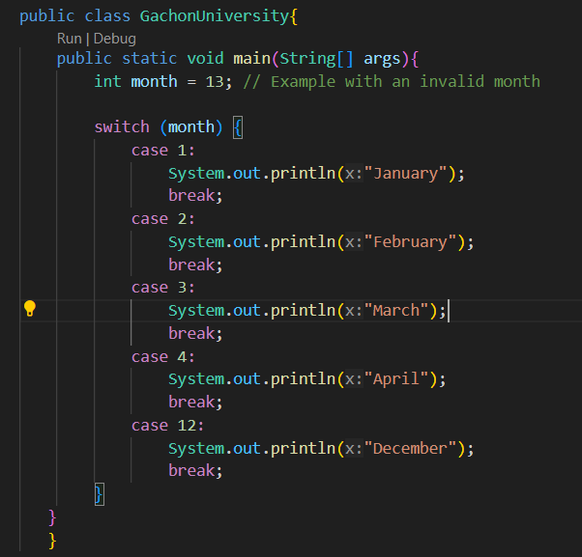

Example: Without the default Keyword
The following example demonstrates the use of the default keyword with a switch statement:
Output

Slide 20
Task 3:
You are given fruit ‘apple’ you have to check fruit to type with fruits for case [‘banana’, ‘peach’, ‘lemon’, ‘apple’] , if the given fruit matches with any of them print “this fruit is [name]” otherwise print “unknown fruit”.

Slide 21
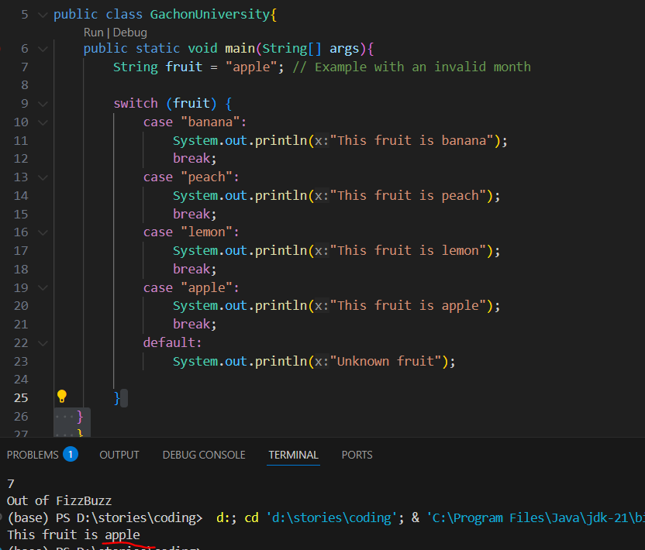

Slide 22
Task 4: Game Menu
You’re given menu of the game and your task to make user input code.
1 -> "Start Game"
2 -> "Load Game"
3 -> "Exit"
default -> “Invalid option”

Slide 23
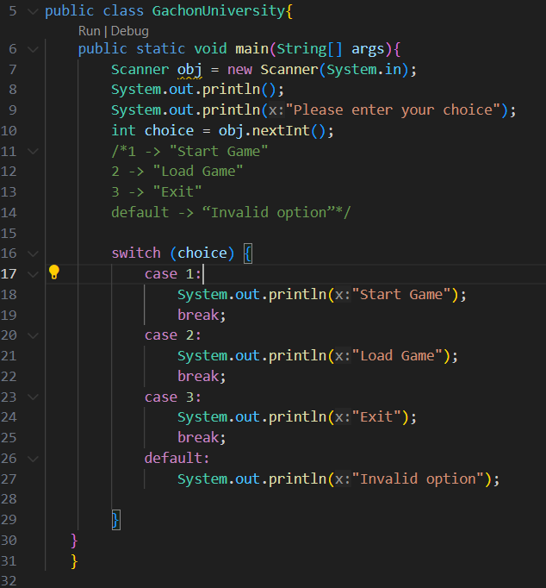





Slide 24
Task 5: Food ordering using String
In this task you’re given menu of cafeteria and your task is to make code for this menu, [‘Burger’, ‘Salad’, ‘Pizza’, ‘Coffee’, ‘Ice cream’] for each of them your task is to print "You ordered a [name]." for Default mode print "We don't have that."

Slide 25
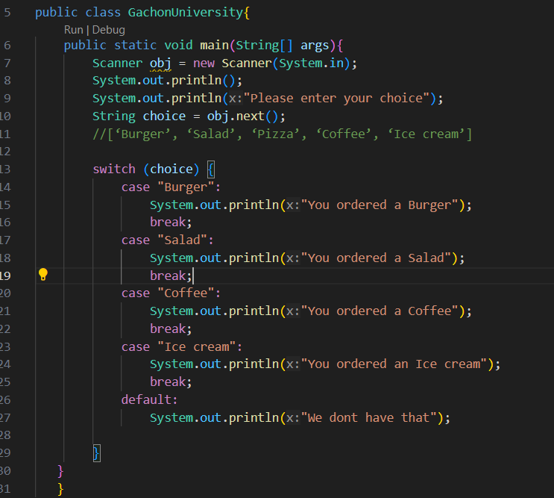
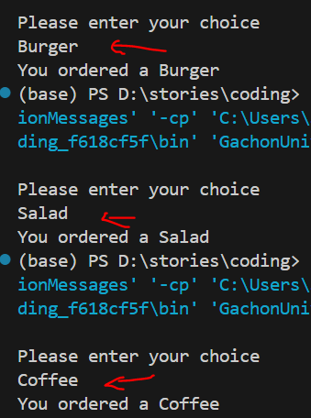
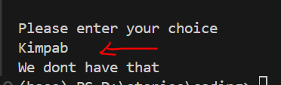

Slide 26
Task 6: Day of the Week
Your task is to make a programm which will give the gay of the week according to the USER INPUT number from [1..7] as the default assign “The number exceeds the limit”!
example:
if user input is 5 your answer must be “Friday”

Slide 27
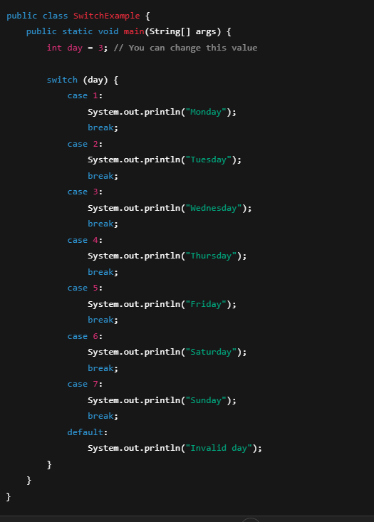
output:
“Wednesday”

